Slide 1
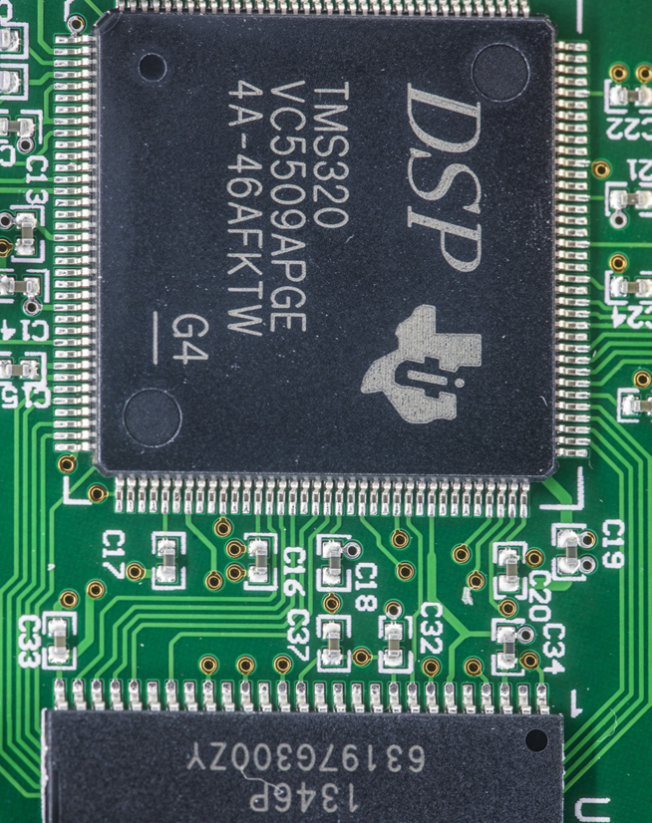
Digital Signal Processing ECG Graph Monitoring
Under supervision :
Dr. Heba Emara
Eng. Ahmed Fathy
Team work :
Ali Osama Ebeid
Abdelrahman Shrief Ali
Sondos Reda Ghareeb

Slide 2
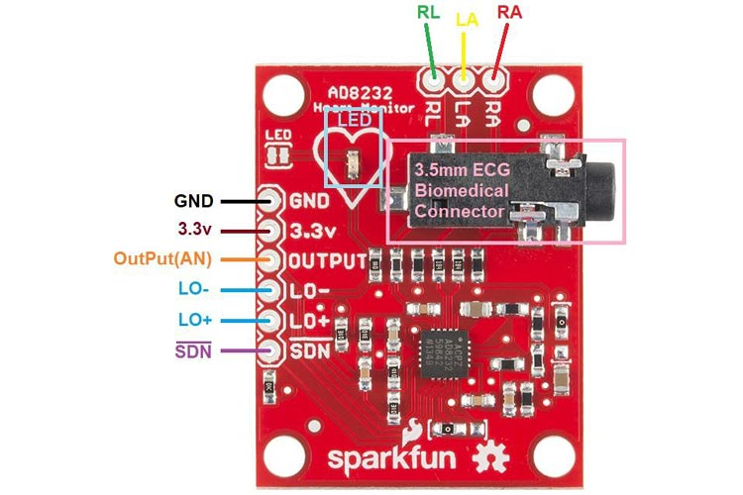
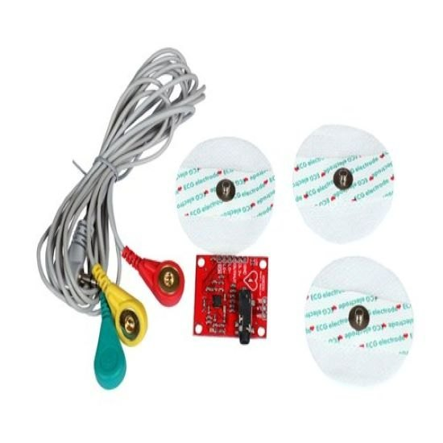
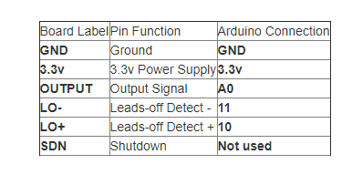
The main Component of the project
ECG module electrodes
Table of connection with arduino
ECG module pinout

Slide 3
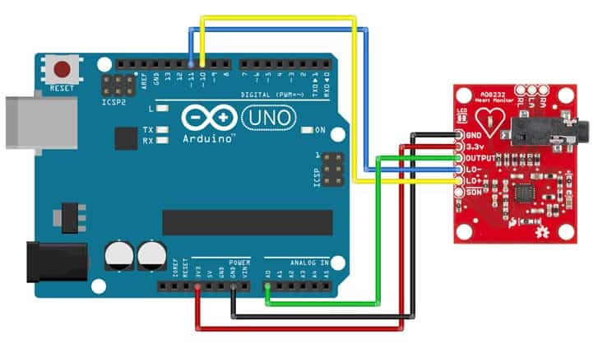
Hardware project

Slide 4
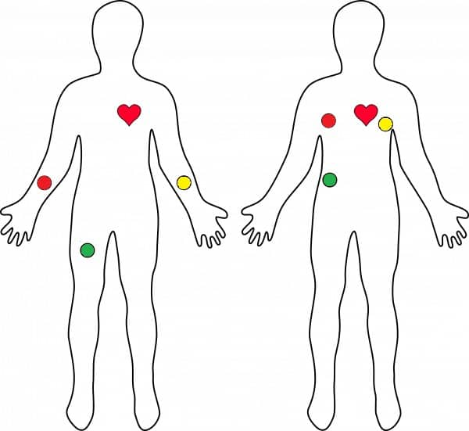
Body placement

Slide 5
Software of Arduino
Start
initialize Serial communications
Pin configuration
Check the input pins read high signal
No
Print ‘ ! ‘
Yes
Read from the analog pin
Delay to avoid saturation
End

Slide 6
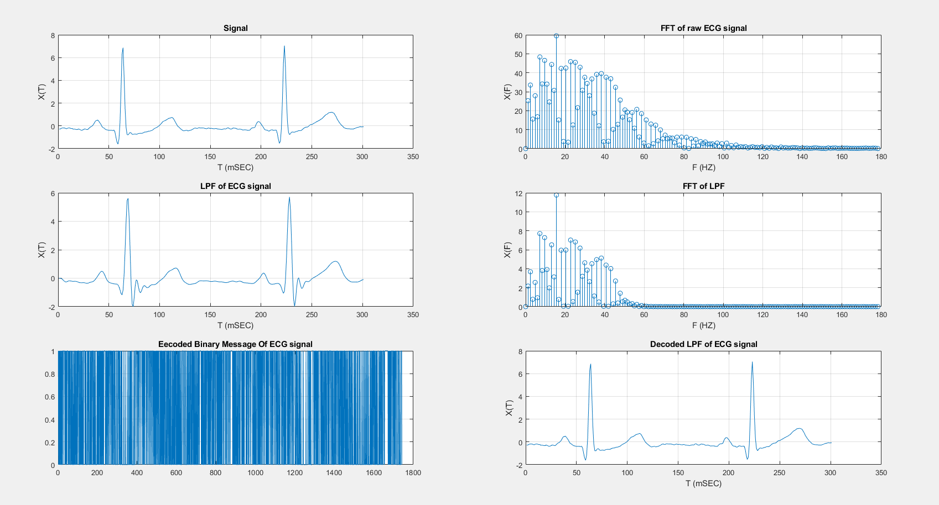
MATLAB code:

